Slide 1
UNIT 5B: FAMILIES IN CHINA

Slide 2
WARM-UP
What country is it?

Slide 3
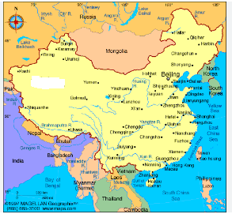
This country has the population of more than 1.4 billion.

Slide 4
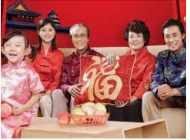
In this country, each family used to have only one child

Slide 5
In this country, red color means good luck to the people.
Good luck

Slide 6
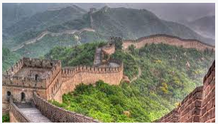
This country is famous for The Great Wall.

Slide 7
A. Vocabulary
Emperor
Obey (V)
Have an impact on (V)
Increase (V)
Feel annoyed/ confident/ independent
Take a decision
Addiction
Under pressure
Vua
Nghe lời
Ảnh hưởng đến…..
Tăng
Cảm thấy phiền/ tự tin/ độc lập
Ra quyết định
Nghiện
Chịu áp lực

Slide 8
READING Read the text “The little emperors” and mark True (T) or False (F)

Slide 9
T or F?
1. Chinese families have become smaller since 1979.
2. In Chinese cities, teenager boys play a lot of sports.
3. Chinese families don’t have much money to spend on their children.
T
F
F

Slide 10
Grammar
1. Teenagers who have no brothers or sisters can feel lonely.
2. In 1979, the Chinese government took a decision which had a big impact on society.
3. It was a time when the government was worried about the population increase.
4. In many cities there are few sports centers or places where teenagers can get together.
=> Relative clause

Slide 11
+ Who, which are called Relative Pronouns
+ When, where are called relative adverbs
+ We use Who for people; which for things; when for times and where for places
*More relative pronouns and relative adverbs such as: whom, whose, why.

Slide 12
Practice

Slide 13
Task 1: Complete the sentences with who, which, where, when
who
1. An emperor is a man …………….. rules a country.
2. Joe’s Café is a place ……………….. we meet our friends.
3. The connection …………….. is the fastest is broadband.
4. The girl …………….. broke up with her boyfriend was lonely.
5. The 1970s was a time …………… many things changed.
6. The teenagers …………………. have got the most money are only children.
Where
which
who
when
who

Slide 14
Task 2: Choose the correct options (a, b, c) to complete the text
A family tree is a kind of diagram (1) ………….. explains your family. It shows the relationships (2) …………… connect people, for example, parents and children. The tree shows (3) ……………. people were born. There are different spaces (4) …………… the people’s names are written. Each generation is written on the same line. Your ancestors- the people (5) ………………… came before you- are at the top of the tree.
1. a. which b. who c. where
2. a. who b. that c. when
3. a. that b. which c. when
4. a. that b. where c. which
5. a. which b. who c. when
a
b
c
b
b

Slide 15
Task 3: Join a sentences in column A with a sentence in column C and a relative pronoun in column B. Sometimes more than one answer is possible
A B C
1. The Artic is the only place people like to relax.
2. Twins are brothers or sisters my sister was born.
3. Beijing is the city which means “to be friends again”.
4. 2002 was the year who wears a nose- stud.
5. There’s a girl in my class that were born at the same time.
6. Make up is a phrasal verb where you can see wild polar bears.
7. The weekend are when the 2008 Olympics were held.

Slide 16
Task 4: Find out the mistake in these sentences and correct it.
1. Have you ever been to Da Lat when my father has a lovely house?
2. Mother’s Day is the day where children show their love to their mother.
3. The film who I watched yesterday was interesting.
4. Do you know the reason when we should learn English?
5. The policeman must try to catch those people whom drive dangerously.

Slide 17
Task 3: Find out the mistake in these sentences and correct it.
1. Have you ever been to Da Lat when where my father has a lovely house?
2. Mother’s Day is the day where when children show their love to their mother.
3. The film who which I watched yesterday was interesting.
4. Do you know the reason when why we should learn English?
5. The policeman must try to catch those people whom who drive dangerously.

Slide 18
Homework
- Do exercise in the workbook for unit 5B
- Do the exercises on page 74 and 75 for Review
- Prepare the lesson for unit 5C

Slide 20
Phrasal verbs
- look up to: kính trọng
- worry about: lo lắng
- fall out with: trục trặc, bất hòa
- break up: tan vỡ, chia tay
- go out with: đi chơi với ….
- make up: quay lại mối quan hệ tốt đẹp
- look after: chăm sóc
- take after: trông giống ai
- get on with: hòa thuận với ai

