Slide 1
Warm-up

Slide 2
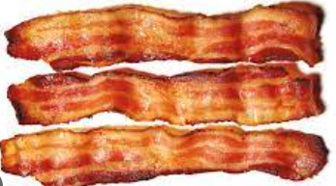
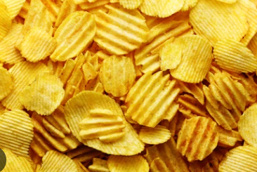
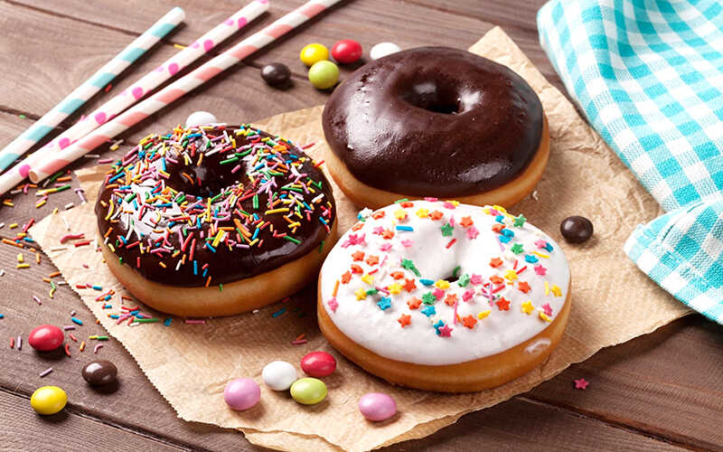
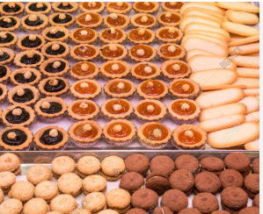
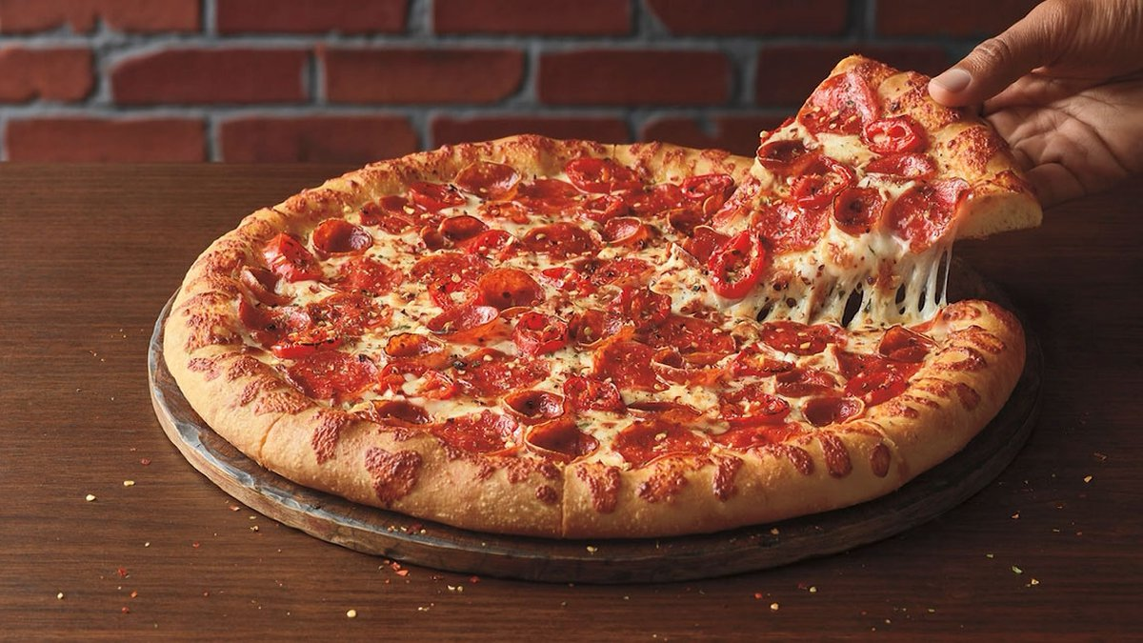
Look at the pictures and write down the name of the food.
sausages
bacon
crisps
doughnuts
pastries
pizza

Slide 3
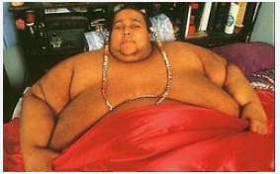
- Who is the man?
- Where does he live?
- How heavy is he?

Slide 4
7B: Reading The big man

Slide 5
I. Vocabulary
enormous
: khổng lồ
waist
: eo, thắt lưng
bicets
: bắp tay
diet
: chế độ ăn kiêng
exhausting
: mệt mỏi
take exercise
: tập thể dục
encourage
: khuyến khích, động viên
get down
: giảm xuống

Slide 6
II. READING
2.2. While-Reading
Task 1: Read the text and check T/F sentences
1. Walter has lost over 400 kilos in ten months.
2. His waist measurement is 119 inches.
3. He used to eat a big breakfast.
4. Walter used to spend almost the whole day in bed.
5. There are a lot of adverts for food on TV.
F
F
T
T
T

Slide 7
II. READING
2.2. While-Reading
Task 2: Read the text again and decide what significance does each number have in the story?
250 | 630 | 96 | 12 - 15 | 119 | 12
He weighs over 250 kilos.
He used to weigh over 630 kilos.
He drank 96 cans of soft drink.
He used to watch TV 12-15 hours a day.
His waist was 119 inches.
He ate two twelve eggs for breakfast.

Slide 8
II. READING
2.2. While-Reading
Task 3: Read the text more carefully to answer the questions
1. What is his problem?
2. What is he doing about it?
3. When did he start doing it?
4. Is he successful? How?
5. How does he want to help other people?

Slide 9
ANSWER
1. What is his problem?
He’s overweight.
(He is used to weigh over 630 kilos. That’s more than half a ton, and it’s heavier than a car or a young elephant).
2. What is he doing about it?
Walter is on a diet.
3. When did he start doing it?
10 months ago.
4. Is he successful? How?
Yes, he is. He weights over 250 kilos. He is losing weight at an incredible 9 kilos a week).
5. How does he want to help other people?
He hopes that his example will help other overweight people, especially children. He encourages mothers to put photos of him on the fridge door. 'I want parents to say to their kids, "Do you want to look that big? If you keep putting your hands in the fridge, then that's how you'll look.

Slide 10
II. READING
2.3. Post-Reading
WHAT SHOULD OR SHOULDN’T YOU DO TO HAVE GOOD HEALTH?

Slide 11
Homework
Write a passage about an overweight person you know.

